Slide 1
2CS701 Compiler Construction
Lab Session

Slide 2
Tools for Compiler Construction Laboratory
Lex / Flex Information
Lex: is a tool to generate lexical analyzers.
divides a stream of input characters into meaningful units (lexemes), identifies them (token) and may pass the token to a parser generator, yacc
Lex specifications are regular expressions
Flex: (fast lexical analyzer generator)
Free and opensource

Slide 3
General Yacc/Bison Information
YACC:- Yet Another Compiler Compiler
It is a tool to generate parsers
Bison
It is a tool to generate parsers
Open source and free

Slide 4
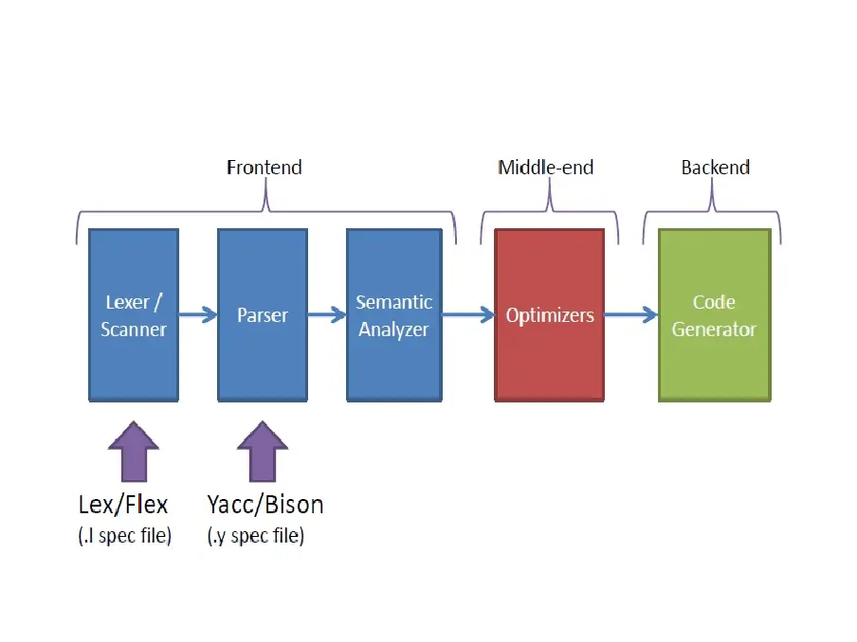
Flex and Bison Relation

Slide 5
Installation of Flex/Lex and Yacc/Bison
On Linux
$ sudo apt install flex
$ sudo apt install bison
On windows
Download Flex from: https://sourceforge.net/projects/winflexbison/
Download Bison from: https://sourceforge.net/projects/winflexbison/
Download DevC++
Install Flex at "C:\GnuWin32"
Install Bison at "C:\GnuWin32"
Install DevC++ at "C:\Dev-Cpp"
Open Environment Variables.
Add "C:\GnuWin32\bin;C:\Dev-Cpp\bin;" to path.
http://www.surajgaikwad.com/2013/10/compile-lex-and-yacc-progs-on-windows.html
On iOs
$ brew install flex
$ brew install bison

Slide 6
LEX / FLEX
A Lexical Analyzer generator tool
Lexical analyzer role: translate set of characters into set of tokens

Slide 7
Automatic Generation of Lexer (Lexical Analyzer) using lexical analyzer generators i.e. lex/flex
lex source program lex.l
lex or flex compiler(lexical
analyzer generator)
> lex mylex.l
> gcc lex.yy.c
> a.out
lex.yy.c
C compiler
lex.yy.c
a.out
input stream
a.Out
(Lexical
Analyzer)
sequence of tokens
7
Prof Monika Shah (Nirma University)

Slide 8
Format for Lex Programs
%{ //declaration section
//Pre-processor statements e.g. Include<stdio.h>
//Variable declaration
//function declaration
%}
%% //Translation rule section e.g
Regular Expression1 {translation rule1}
Regular Expression2 {translation rule2}
…
Regular Expressionn {translation rulen}
%%
// ... user subroutines / functions ...

Slide 9
The definition section can include the
literal block, definitions, internal table declarations, start conditions, and translations
The Rules section contains pattern lines and C code.
A line that starts with whitespace, or material enclosed in “%{” and “%}” is C code. A line that starts with anything else is a pattern line.
C code lines are copied verbatim to the generated C file. ...
User Subroutine
main() {
yylex();
}

Slide 10
Regular Expressions in Lex
x match the character x \. match the character . “string” match contents of string of characters . match any character except newline ^ match beginning of a line $ match the end of a line [xyz] match one character x, y, or z (use \ to escape -) [^xyz]match any character except x, y, and z [a-z] match one of a to z r* closure (match zero or more occurrences) r+ positive closure (match one or more occurrences) r? optional (match zero or one occurrence) r₁r₂ match r₁ then r₂ (concatenation) r₁|r₂ match r₁ or r₂ (union) ( r ) grouping r₁\r₂ match r₁ when followed by r₂ {d} match the regular expression defined by d
Prof Monika Shah (Nirma University)

Slide 11
Example 1 : Recognize integer constants, discard newlines, and print error for other characters
Program1.l file
%{
#include <stdio.h>
%}
%%
[0-9]+ { printf(“%s is NUM\n”, yytext); }
\n { }
.+/” “ {printf(“%s invalid token\n”, yytext);} %%
main()
{ yylex();
}
Contains the matching lexeme
Translation rules
Invokes the lexical analyzer
lex spec.l gcc lex.yy.c -ll ./a.out < test.c
Prof Monika Shah (Nirma University)

Slide 12
Execution of a Lex program
$ Lex Program1.l ➔ Will generate the file lex.yy.c
$ gcc lex.yy.c ➔ will generate a.out in linux / a.exe in windows
➔ a.out is lexical analyzer for your program
$ ./a.out < test.c ➔ Execute lexical analyzer for inputs written in test.c file
Sample input file (test.c): Sample Output
a = 2 ; a = is invalid token
2 is NUM
Refer next slide for common errors

Slide 13
Lex/ Flex error
Unrecognized rule at line 10
Cause : Regular expression specified at line 10 covers pattern , which is covered in regular expression specified before (previous lines)
E.g. int string match already with first regular expression
[_a-zA-Z][_a-zA-Z0-9]* {printf(“ID”);}
“int” {printf(“Keyword”);}
Solution : 1. correct regular expression 2. Change order of regular epression

Slide 14
gcc error
Undefined reference to yywrap
Cause : Not able to find object code for yywrap function, which is used implicityly
Solution :
Linux operating system
Link with lex library
gcc program1.l -ll
Link with flex library
gcc program1.l -lfl
Windows operating system
Override yywrap () function . Add following subroutine in .l file
int yywrap()
{ return 0;}

Slide 15
gcc error
Undefined reference to WinMain
Cause : Windows operating system expects main function
Solution :
Add following subroutine in .l file
int main()
{
yylex();
return 0;}

Slide 16
Example Lex Specification 1
%{
#include <stdio.h>
%}
%%
[0-9]+ { printf(“NUM\n”); }
\n { }
.+/” “ {printf(“%s invalid token\n”, yytext);} %%
main()
{ yylex();
}
Contains the matching lexeme
Translation rules
Invokes the lexical analyzer
lex spec.l gcc lex.yy.c -ll ./a.out < test.c
Prof Monika Shah (Nirma University)

Slide 17
Example 2: Lex program to recognize integer , float, character constants, operators and identifier tokens and translate set of characters to set of tokens
Input: test.c file with expression statements
e.g.
area = 22/7.0 * radius * radius
Output: ID = NUM / FNUM * ID * ID

Slide 18
Example 2: Lex program to recognize integer , float, character constants,operators and identifier tokens and translate set of characters to set of tokens
%{
%}
%%
[0-9]+ {printf(“NUM ”);}
[0-9]*”.”[0-9]+ {printf(“FNUM ”);}
[_a-zA-Z][_a-zA-Z0-9]* {printf(“ID ”);}
[-+=*/] {ptintf(“ %c \n”,yytext[0]);}
%%
int main()
{ yylex(); //call lexical analyzer
return 0;
}

Slide 19
Example Lex Specification 3
%{
#include <stdio.h>
int ch = 0, wd = 0, nl = 0;
%} delim [ \t]+
%%
\n { ch++; wd++; nl++; }
^{delim} { ch+=yyleng; }
{delim} { ch+=yyleng; wd++; }
. { ch++; }
%%
main()
{ yylex();
printf("%8d%8d%8d\n", nl, wd, ch);
}
Translation rules
Regular definition
Prof Monika Shah (Nirma University)

Slide 20
Example Lex Specification 4
%{
#include <stdio.h>
%} digit [0-9] letter [A-Za-z] id {letter}({letter}|{digit})*
%%
{digit}+ { printf(“number: %s\n”, yytext); }
{id} { printf(“ident: %s\n”, yytext); }
. { printf(“other: %s\n”, yytext); }
%%
main()
{ yylex();
}
Regular definitions
Translation rules
Prof Monika Shah (Nirma University)

Slide 21
Example Lex Specification 5
%{ /* definitions of manifest constants */
#define LT (256) …
%} delim [ \t\n] ws {delim}+ letter [A-Za-z] digit [0-9] id {letter}({letter}|{digit})* number {digit}+(\.{digit}+)?(E[+\-]?{digit}+)? %% {ws} { } if {return IF;} then {return THEN;} else {return ELSE;} {id} {yylval = install_id(); return ID;} {number} {yylval = install_num(); return NUMBER;} “<“ {yylval = LT; return RELOP;} “<=“ {yylval = LE; return RELOP;}
“=“ {yylval = EQ; return RELOP;}
“>“ {yylval = GT; return RELOP;}
%%
int install_id() …
Return token to parser
Token attribute
Install yytext as identifier in symbol table

